Slide 1
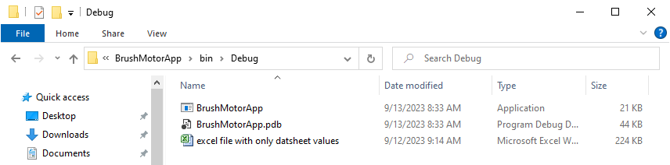
Located in the same directory of “BrushMotorApp” is the file “excel file with only datasheet values.”

Slide 2
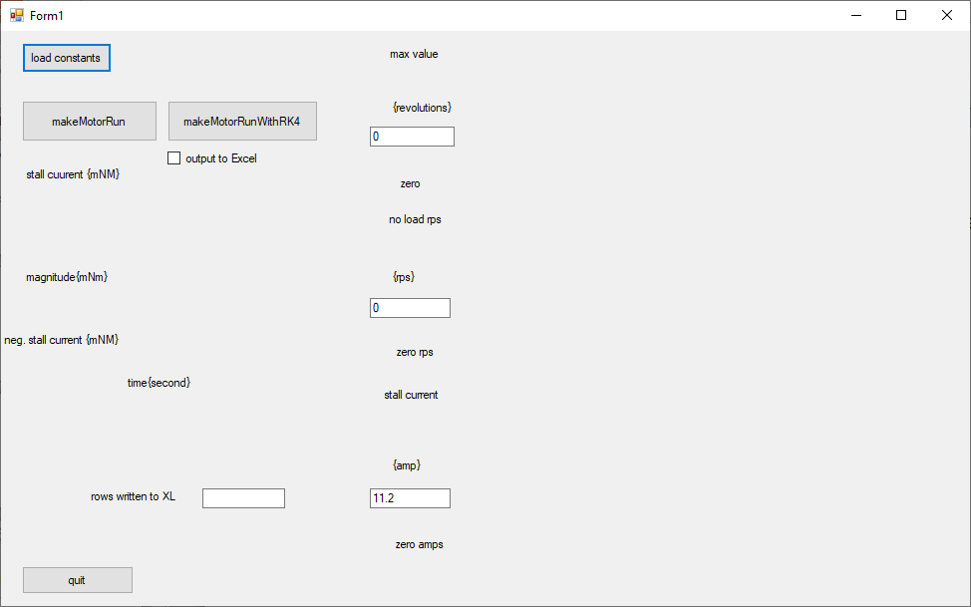
Double-clicking BrushMotorApp will execute the application to generate this screen:

Slide 3
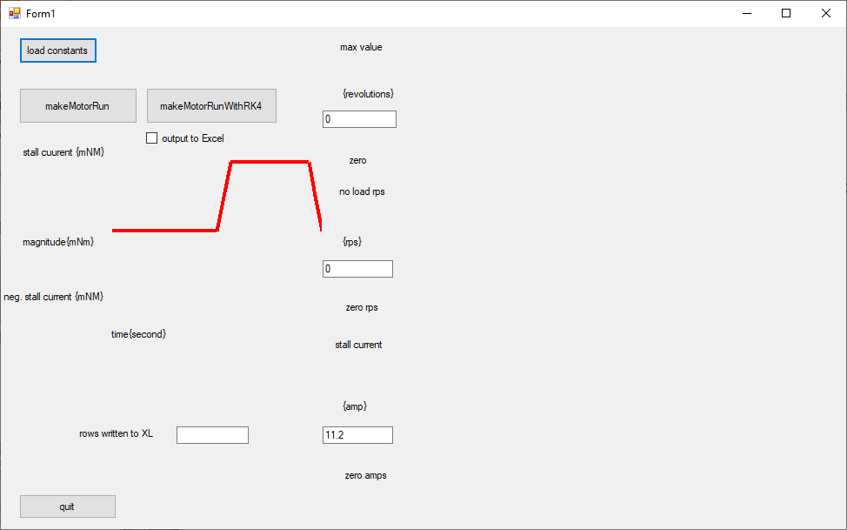
Clicking “load constants” will load the datasheet from the collocated Excel file and paint a user defined function

Slide 4
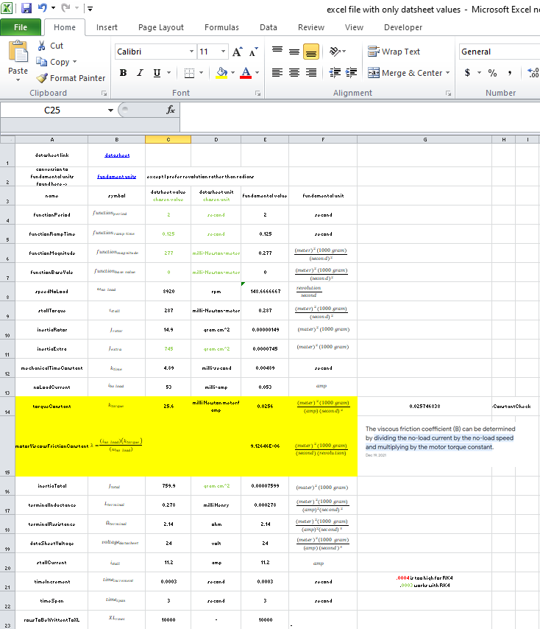
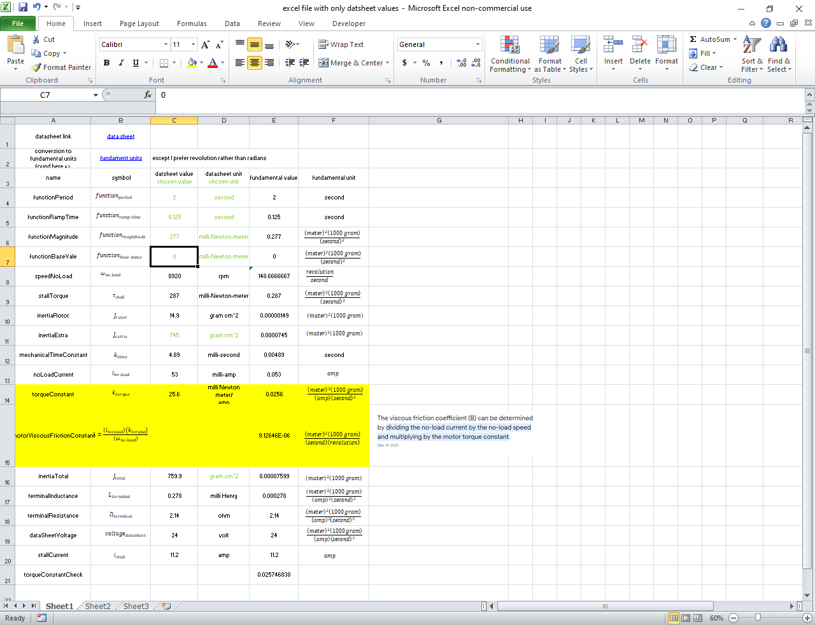
I transferred values from the Maxon data sheet to this spreadsheet. I think that the motor you are interested in will have a similar data sheet. This file should be located in the same folder as the Brush Motor Application
Note that I prefer numbers with fundamental units except for radians -- I prefer whole revolutions.

Slide 5
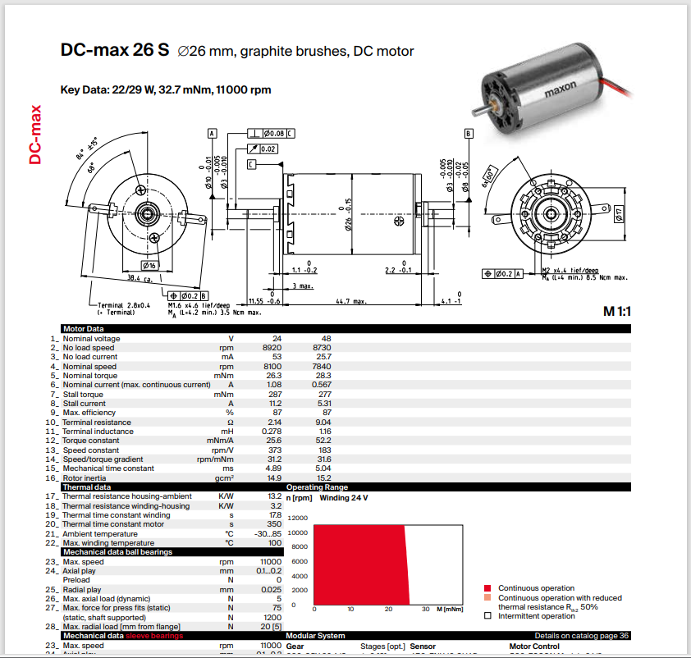
Clicking the datsheet link should bring up the Maxon 22 122 data sheet if it’s located in the same folder as Brush Motor App.

Slide 6
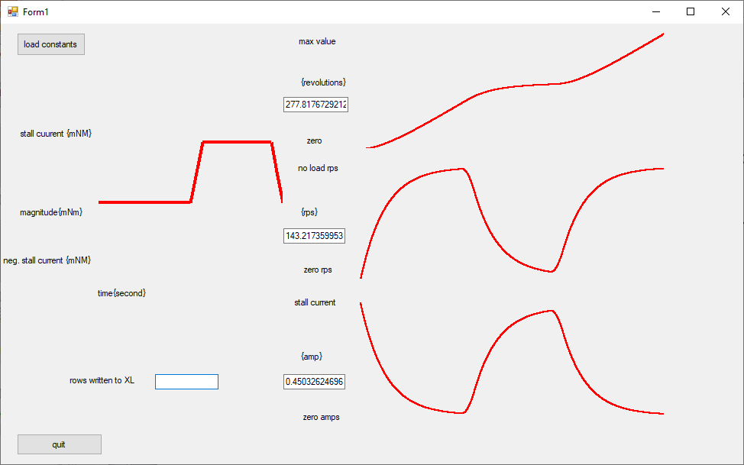
Click the “makeMotor run with RKIV” or “makeMotor run button. This will document the position, speed, and electrical current consumption of the motor as calculated over 2.5 seconds specified in the Excel sheet.
Check “output to excel” before signaling the motor to run, and will transfer the data shown graphically to an the Excel worksheet.

Slide 7
Backup slides follow

Slide 8
Future Work
Correct spelling of “excel”
Better document of initial conditions
Variable time constant
Add alternative to “makeMotorRun” that calculates position speed and current through numerically solving three simultaneous differential equations
Better position all graph axis labels.
Add ability to control the “step size” .0004 is too large; .0003 works
Document exponential functions used
Eliminate linked list of datapoints?
When is known how large the array should be
Test cases
No load
Constant load
Load that turns on after a second and off at second two

Slide 9
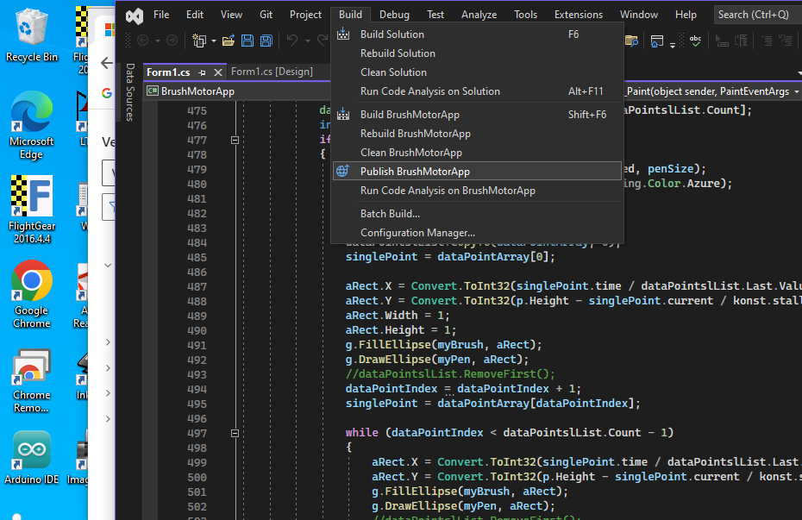
C:\Users\Todd Westley\BrushMotorApplication\BrushMotorApp\bin\Publish

Slide 10
